Slide 1
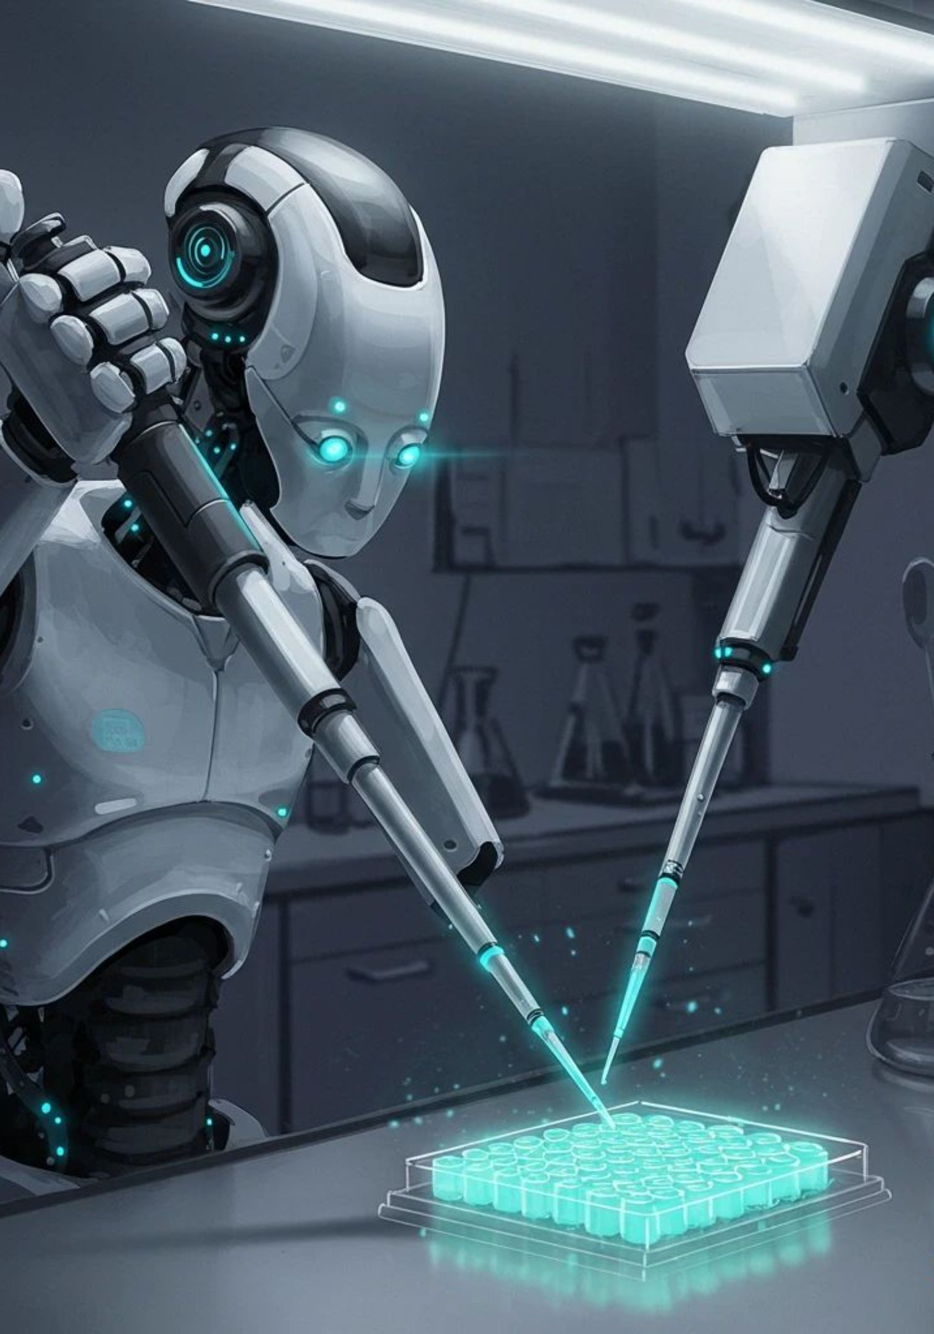
Mobile Intelligent Robotic Arm Interface (MIRAI)
Progressive Development of an Autonomous Omnidirectional Robotic Arm
Team: Livity Labs
Mentor: Dr. Kishore Ayyala Ajay Kumar—K.R. Mangalam University, School of Engineering & Technology

Slide 2

Problem Statement & Goal
The Problem
Our Goal
Most low-cost robotic arms are either fully manual or attempt full autonomy in one leap — making them hard to validate, debug, and defend as a working system. There is no gradual, testable pathway from a simple manipulator to an autonomous mobile robot that a student team can realistically build stage by stage.
Develop a 6-DOF robotic arm mounted on an omnidirectional mobile platform that evolves across three clearly defined stages — from a manually controlled manipulator into a fully autonomous pick-and-place robot.
Current focus: Stage 1 — proving the arm can physically perform accurate manipulation before adding mobility or autonomy.

Slide 3

Project Development Pipeline
Three progressive stages — each validates one capability before the next is added. This staged approach ensures every subsystem is proven and debuggable before complexity increases.
Autonomous Mobile Manipulator
Mobile Omnidirectional Arm
Fixed Robotic Arm
Each stage builds on the last, creating a verifiable, incremental path from a basic manipulator to a fully autonomous mobile robot.

Slide 4
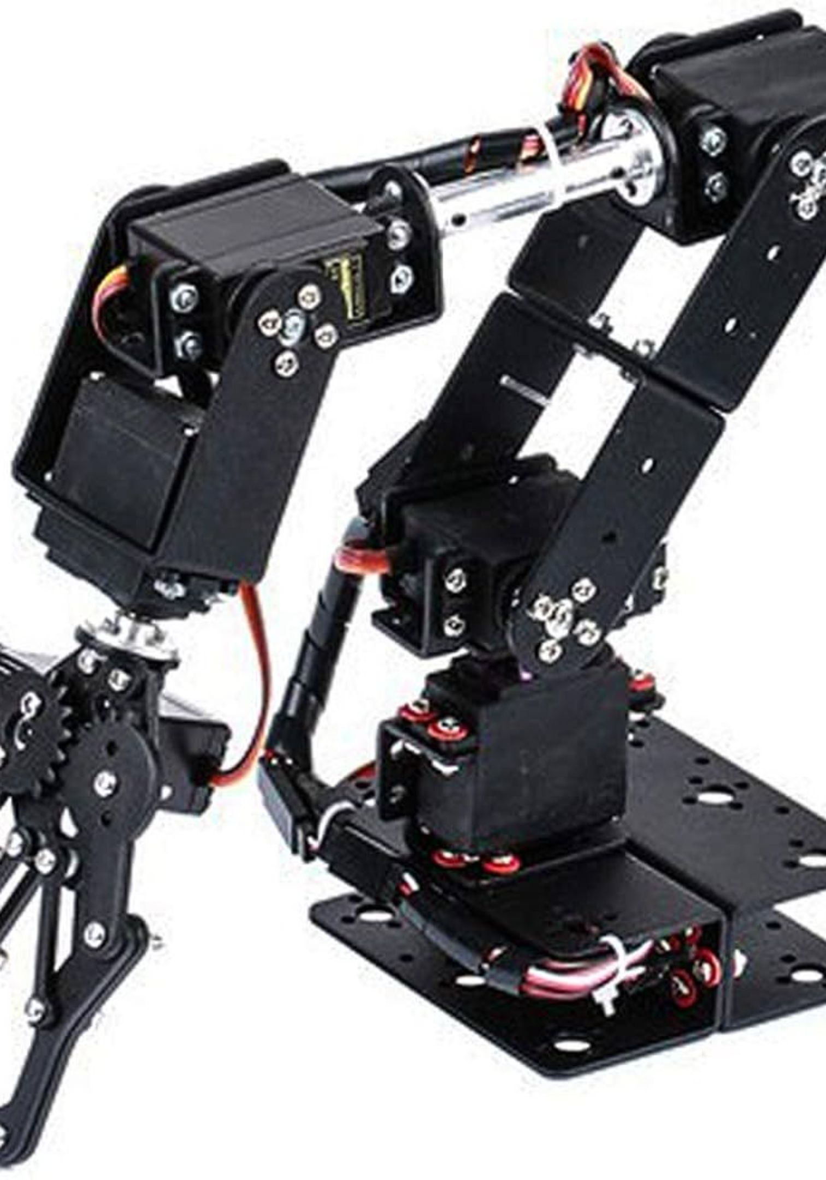
Stage 1 — Fixed Robotic Arm
Objective
Main Task
Build and validate the 6-DOF robotic arm as a stationary manipulator before introducing mobility or autonomy.
Successfully pick a LEGO or small object using the camera for detection, and place it at a new location — using fully manual control.
Testing Focus
Test all 6 DOF & servo movement, arm positioning accuracy, gripper opening/closing, object picking & placement, and validate mechanical design.

Slide 5
Stage 1 — Pick & Place Pipeline
Before making the robot autonomous, we must prove the arm itself can physically perform accurate manipulation. This 8-step sequence validates the full manual control loop.
01
02
Object Detected / Observed
User Controls Arm
03
04
Arm Moves to Object
Gripper Closes
05
06
Object Picked
Arm Moves to Destination
07
08
Gripper Opens
Object Placed Successfully

Slide 6
Components List — Stage 1
Category | Component Name | Qty | Unit Price | Total Cost
Actuators | MG996R 180° Servos (9.4 kgf·cm) | 3 | ₹1,317/pack | ₹1,317
Actuators | MG90S Metal-Gear Servos (2.2 kg·cm) | 3 | ₹439 | ₹439
Control | PCA9685 16-Channel Servo Driver | 1 | ₹480 | ₹480
Main Brain | ESP32 Dev Board + GPIO Expansion | 1 ea | ₹342 / ₹219 | ₹561
Vision | ESP32-CAM (OV2640) | 1 | ₹849 | ₹849
Power | 3S LiPo Battery 2200mAh + iMAX B6 Charger | 1 ea | ₹1,899 / ₹2,689 | ₹4,588
Power | XL4015 5A Buck Converter | 1 | ₹249 | ₹249
Wiring | Jumper Wires, Extension Cables, Shrink Wrap | — | — | ₹698

Slide 7
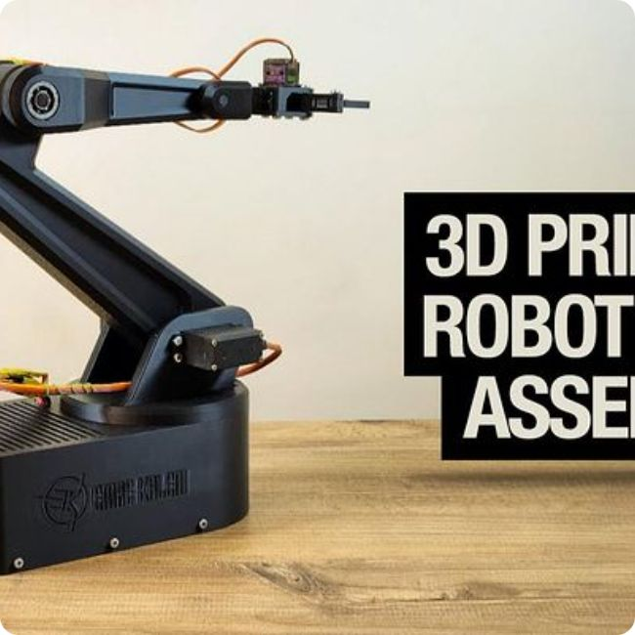
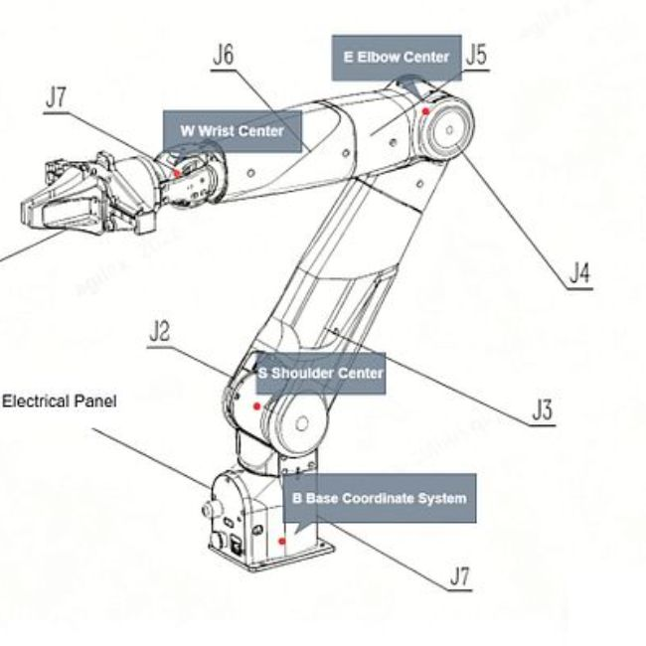
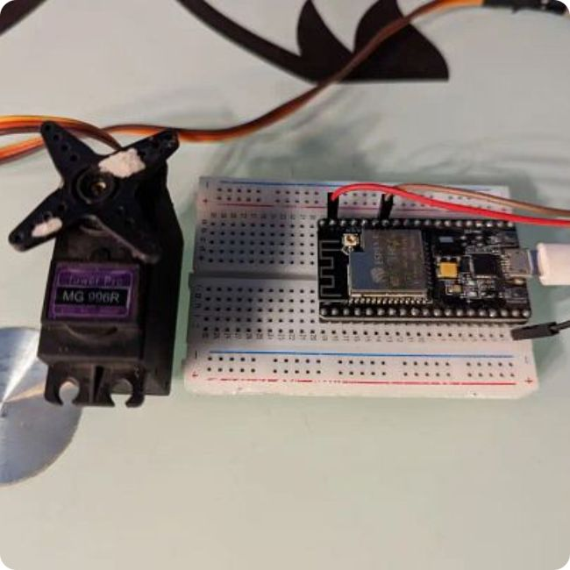
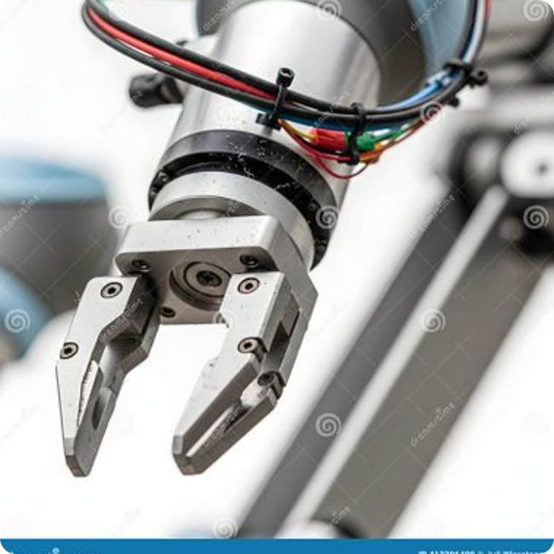
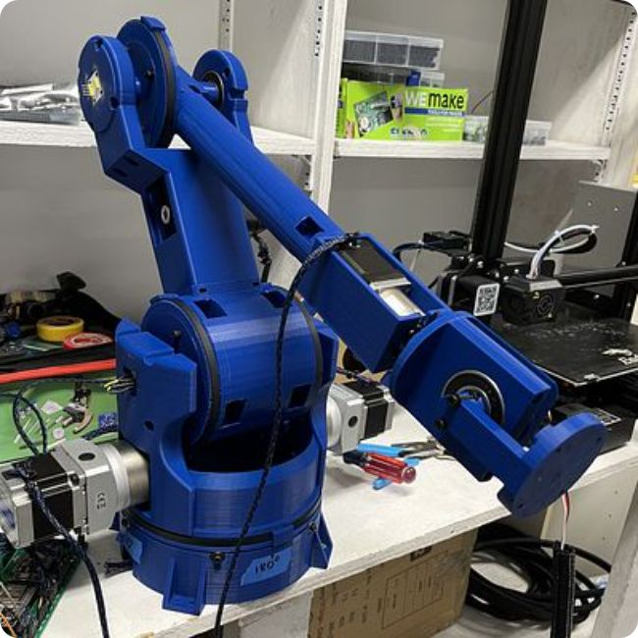
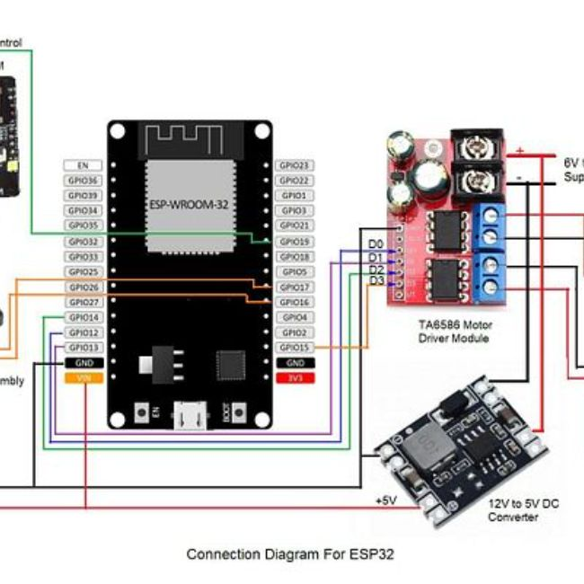
System Assembly — Mechanical Layout

Slide 8
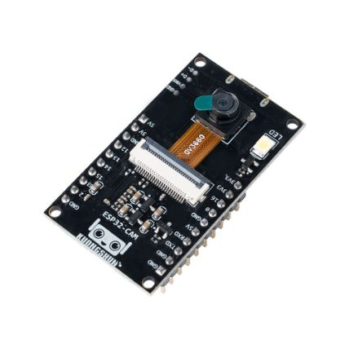
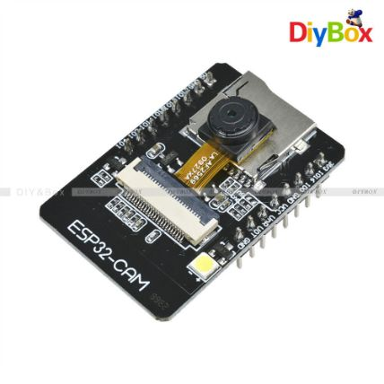
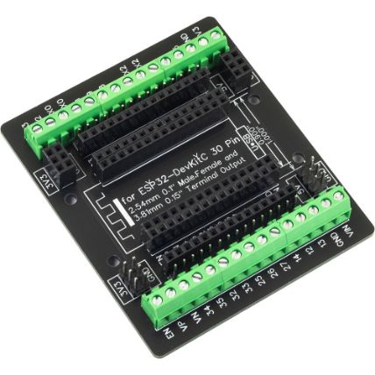
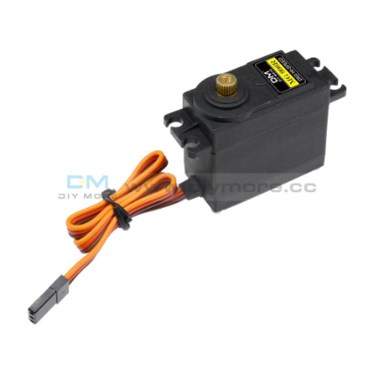
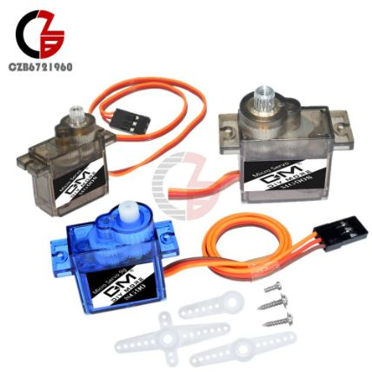
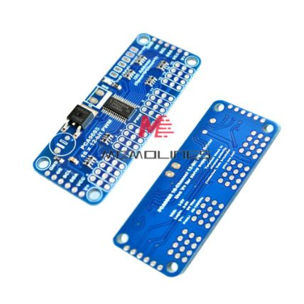
Components Used — Control & Vision
ESP32 Development Board
ESP32-CAM (OV2640)
GPIO Expansion Board
MG996R Servo Motor
Main controller — handles servo PWM generation, camera interface, and serial communication.
Vision input for object detection and live feed. Streams video for manual guidance.
Breaks out ESP32 pins for easier wiring to servos, sensors, and peripherals.
High-torque servos (9.4 kgf·cm) for the base, shoulder, and elbow joints.
SG90 Micro Servo
PCA9685 Servo Driver
Lightweight servos for wrist rotation and gripper actuation.
16-channel I²C PWM driver — controls all 6 servos from the ESP32 with a single wire pair.

Slide 9
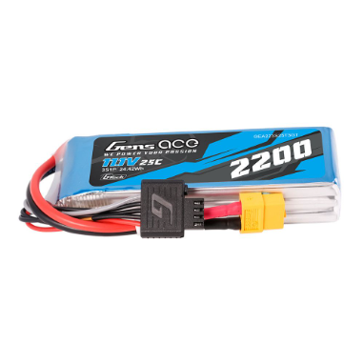
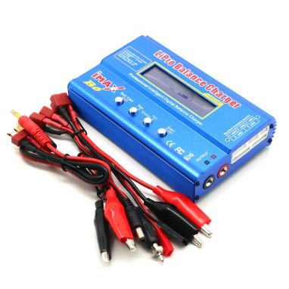
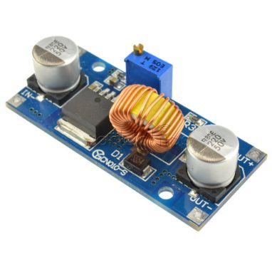
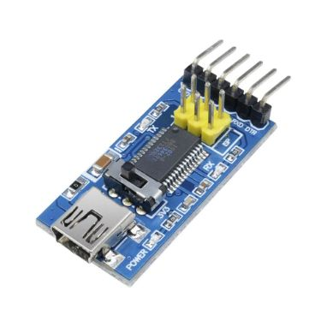
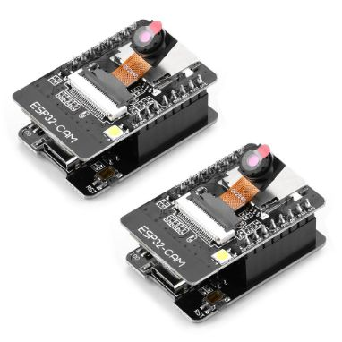
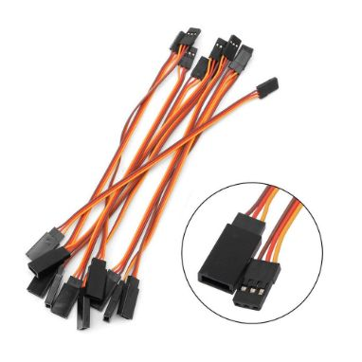
Components Used — Power & Accessories
3S LiPo Battery (2200mAh)
iMAX B6 Balance Charger
XL4015 Buck Converter
FTDI Programmer (USB-TTL)
11.1V main power source — delivers high current for all six servos simultaneously.
Safely charges and balances the LiPo pack, protecting battery health and longevity.
Steps down battery voltage to a stable 5V rail for the ESP32 and servo driver.
Flashes firmware to the ESP32 and provides serial debug output during development.
ESP32-CAM Extension Board
Servo Extension Cables
Provides accessible GPIO pins and a USB interface for the ESP32-CAM module.
30 cm extensions route signals cleanly from the driver to each servo joint.

Slide 10
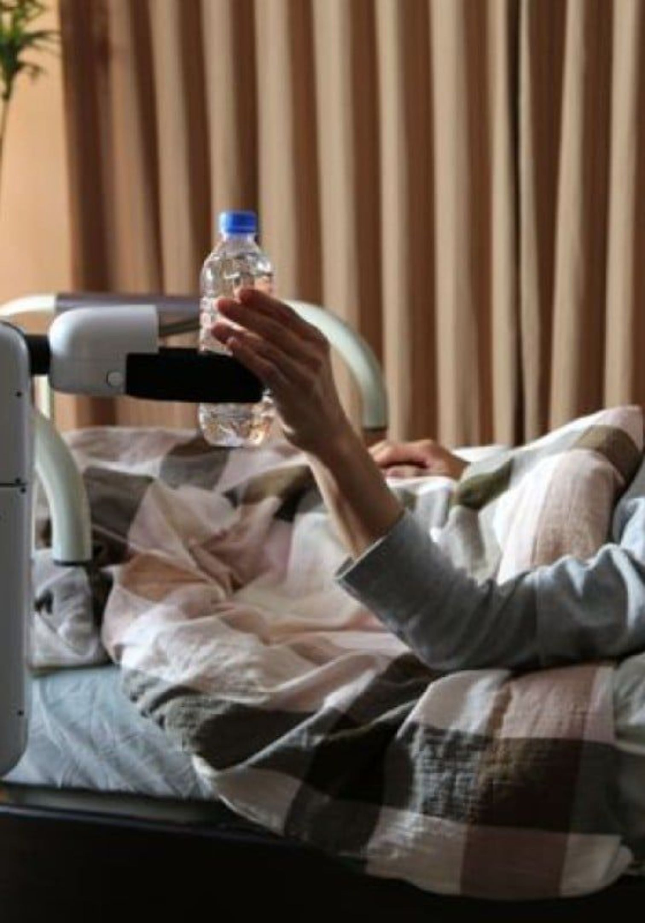
The Future of Care: Our Motivation
The MIRAI project transcends pure engineering; it's driven by a vision to create accessible, assistive technology with genuine human impact.
We envision a future where autonomous robotic arms can support elderly individuals living alone. From fetching daily medications to providing immediate alerts to family in case of an unforeseen event or malfunction, MIRAI aims to enhance safety, independence, and peace of mind for both seniors and their loved ones. This project is about empowering lives through practical, compassionate innovation.

